Slide 1
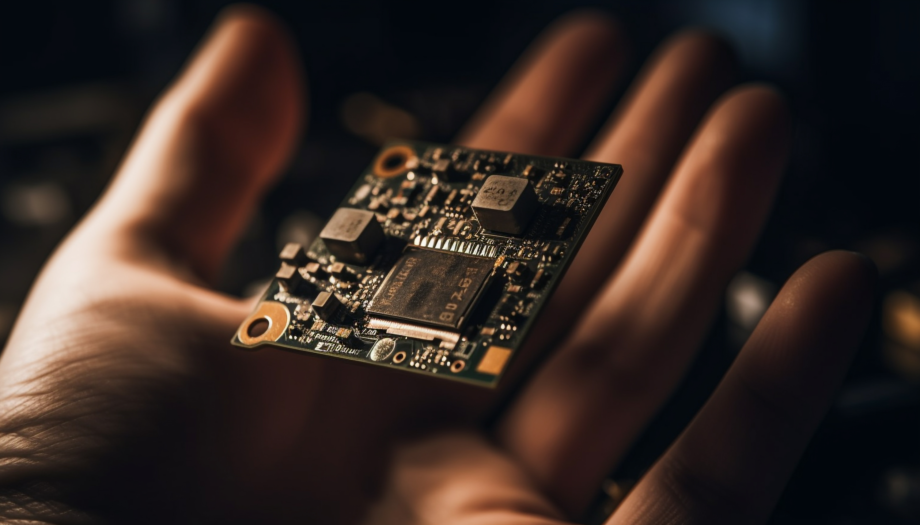
Electronics-ICT Made by Jonas Vanhulst

Slide 2


About me
Studying Electronics-ICT
From the small-town Linter
Fun fact: I love Cycling

Slide 3
Project Roadmap
🚩
✍️
🛠️
🏁
Analyzing
Schematic Design
3D-Design
Finishing
Reading Elector magazine
Downloading software
Finding schematic’s & footprints
Designing schematic’s
Designing PCB
Debugging
Prototyping
Application note

Slide 4

Research
Electronics ICT
Notes:
As I stated earlier, the first thing I did was conducting research.

Slide 5
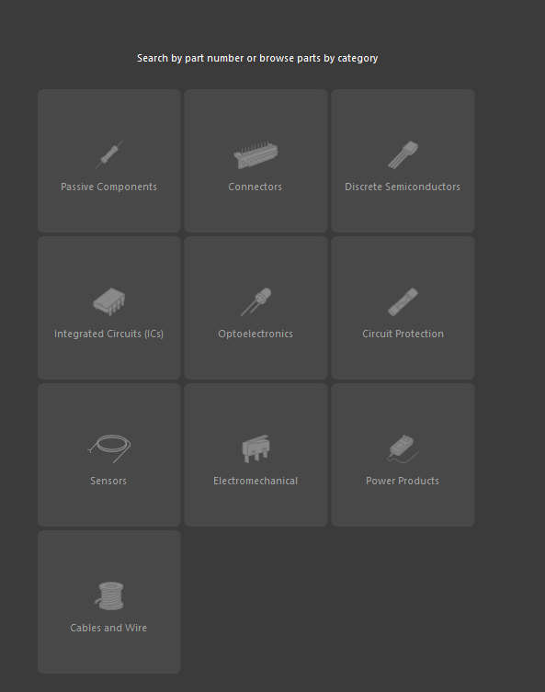
Hardware
Part search
Ordering
Stock

Slide 6
Electrical design
Electronics ICT
Notes:
As I stated earlier, the first thing I did was conducting research.

Slide 7
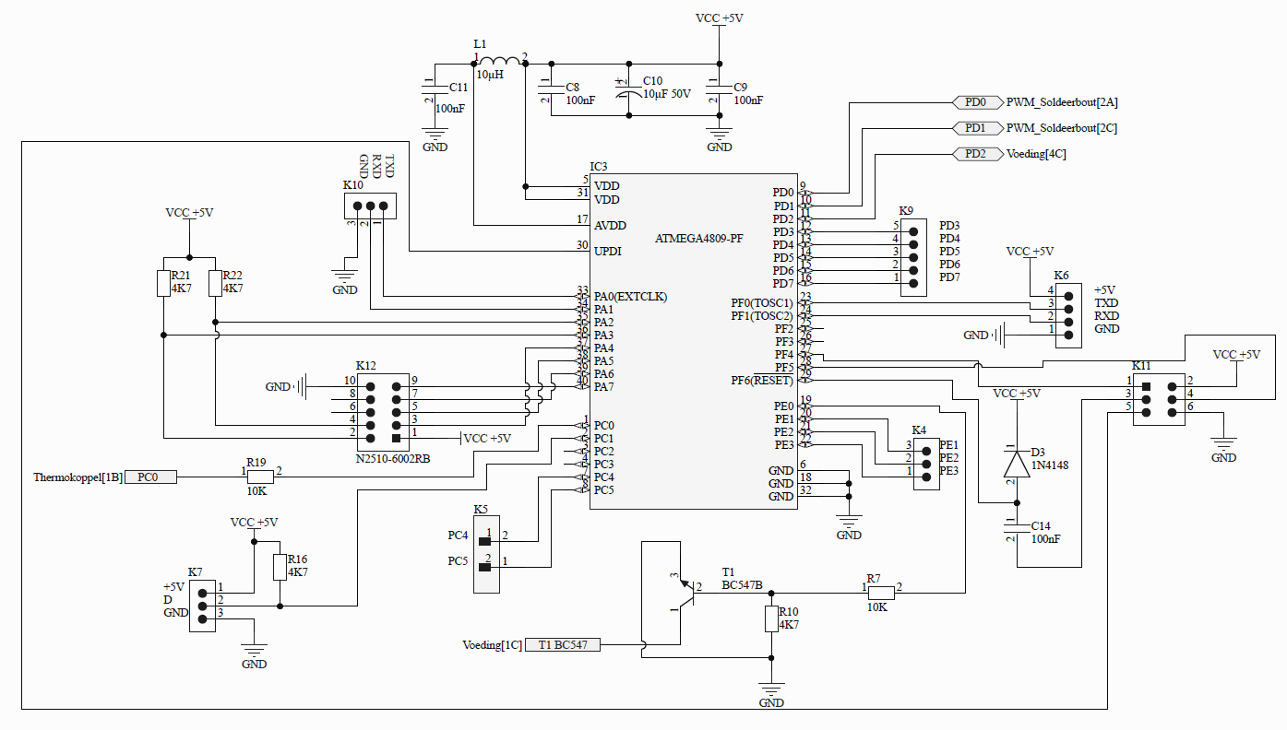
Schematics - Controller
Atmega 4809
Programming pins
Receiving data

Slide 8
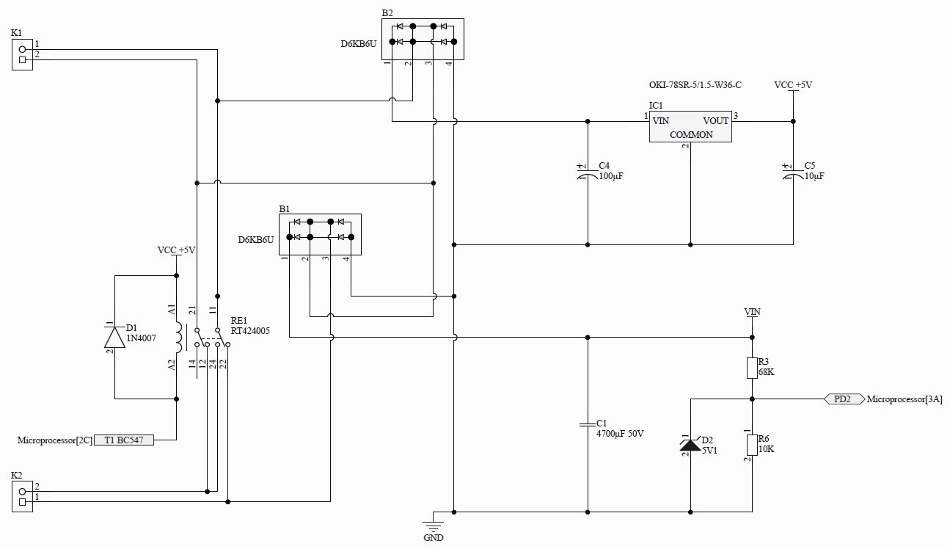
Schematics - Supply
Bridge rectifier
230V AC
5V DC
High voltage protection diode

Slide 9
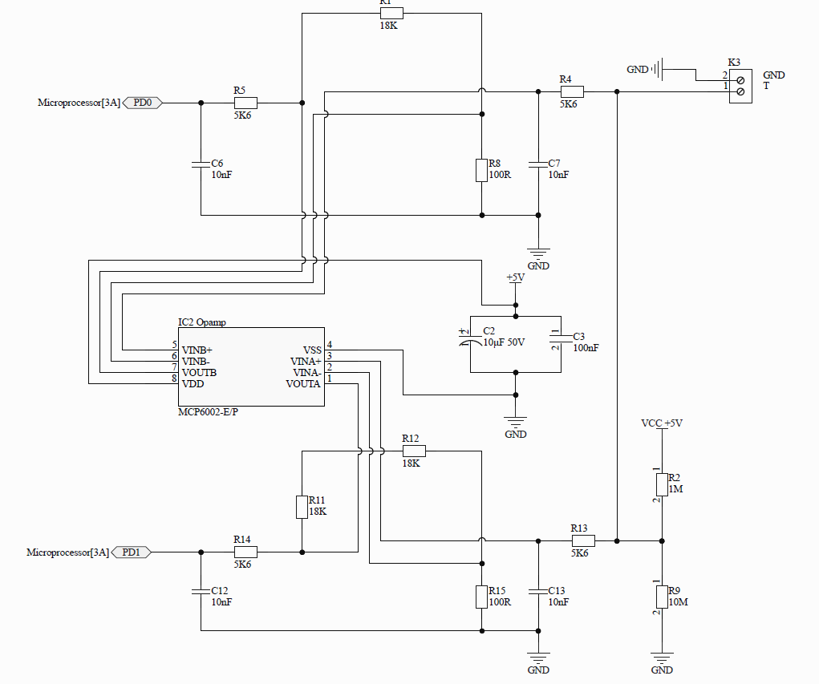
Schematics - Opamp
MCP6002-E/P Opamp
Noise
Amplifier

Slide 10
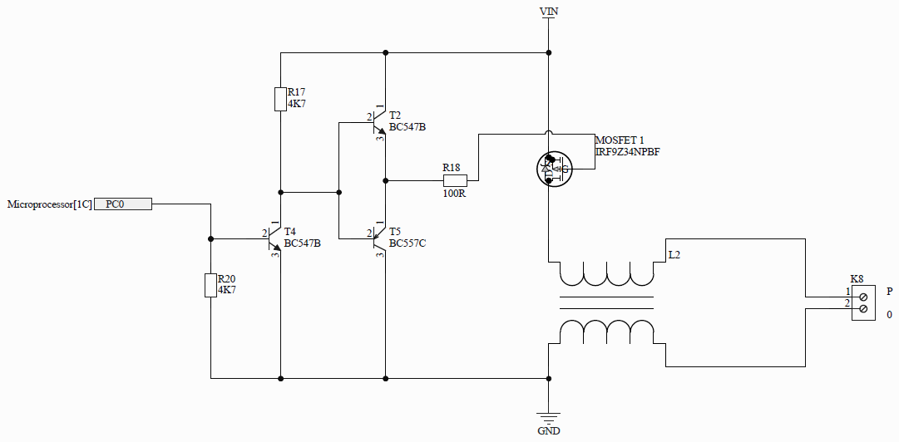
Schematics - Mosfet
Mosfet
Transistor as open switch
Output

Slide 11
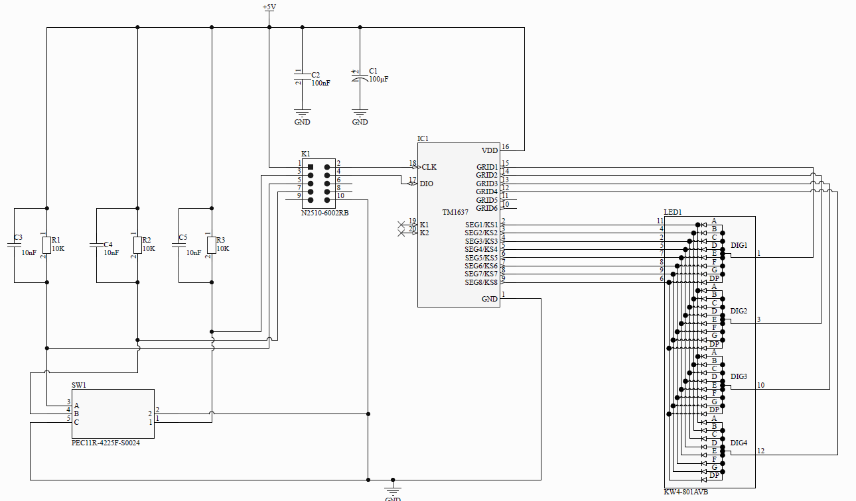
Schematics - Display
TM 1637
Display 4 digit
Rotary encoder

Slide 12
Printed Circuit Board
Electronics ICT
Notes:
As I stated earlier, the first thing I did was conducting research.

Slide 13
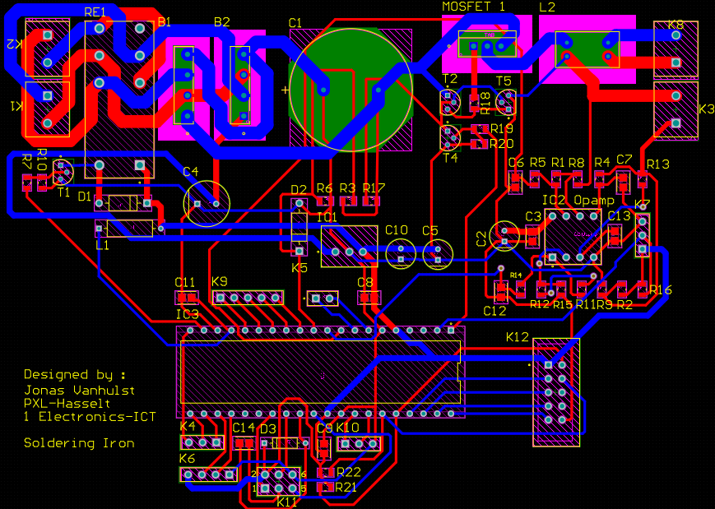
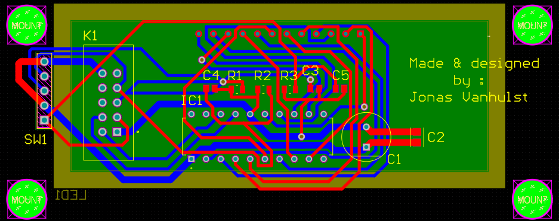
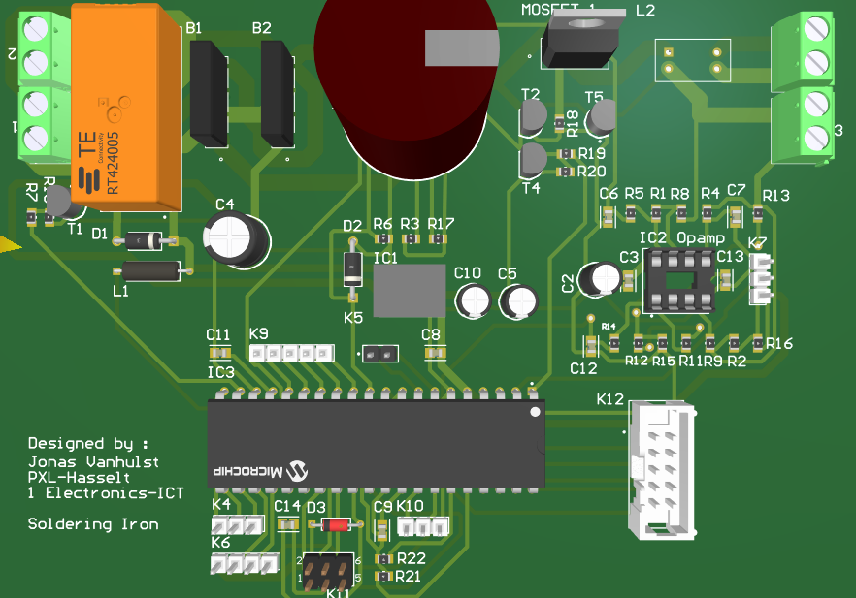
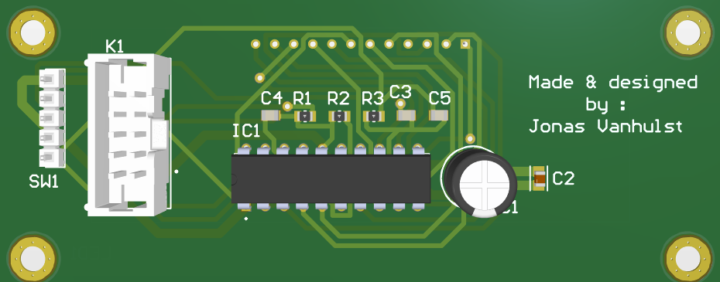
PCB

Slide 14
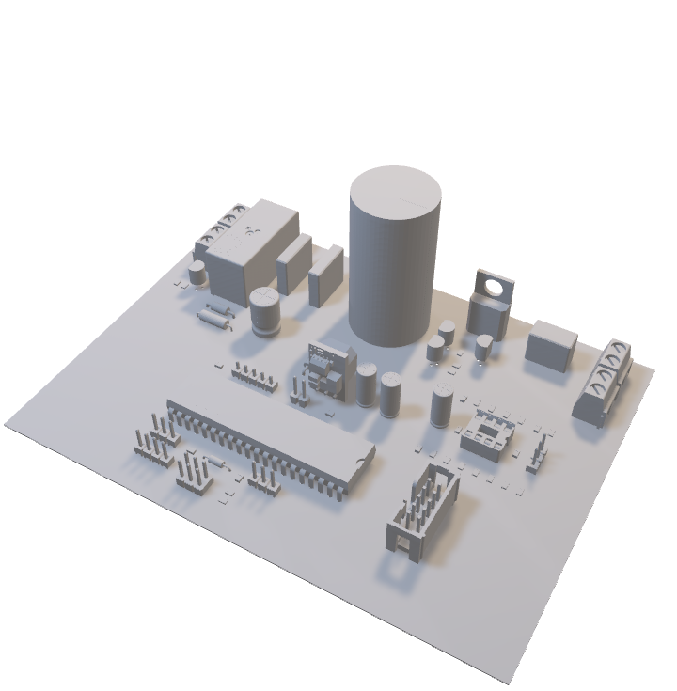
PCB
Printed Circuit Board
Adventages
Clean look
No cables
Better soldering
Easy montage
Clean debug
Disadvantage
Mistakes are permanent
Difficult design

Slide 15
3D Design
Electronics ICT
Notes:
As I stated earlier, the first thing I did was conducting research.

Slide 16
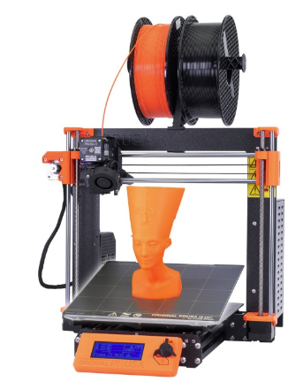


Materials
Prusa slicer

Slide 17
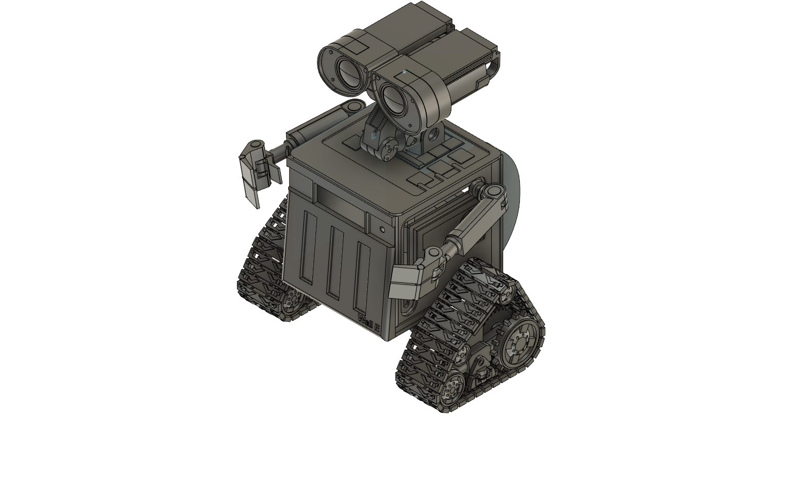
WALL-E
Childhood
Research
Own design

Slide 18
Thanks for listening
Jonas Vanhulst Electronics ICT PXL
Notes:
As I stated earlier, the first thing I did was conducting research.

Slide 19
Notes:
As I stated earlier, the first thing I did was conducting research.

